Slide 1
A Monocular Visual Odometry Experiment Using ORB-SLAM Library
Farhad Mirkazemi
“Any sufficiently advanced technology is indistinguishable from magic”
Arthur C. Clarke

Slide 2
Monocular Visual Odometry
The Act of Determining Moving Target Position and Attitude Using Single Camera Image Sequences
Unique Only Up to A Scale Factor

Slide 3
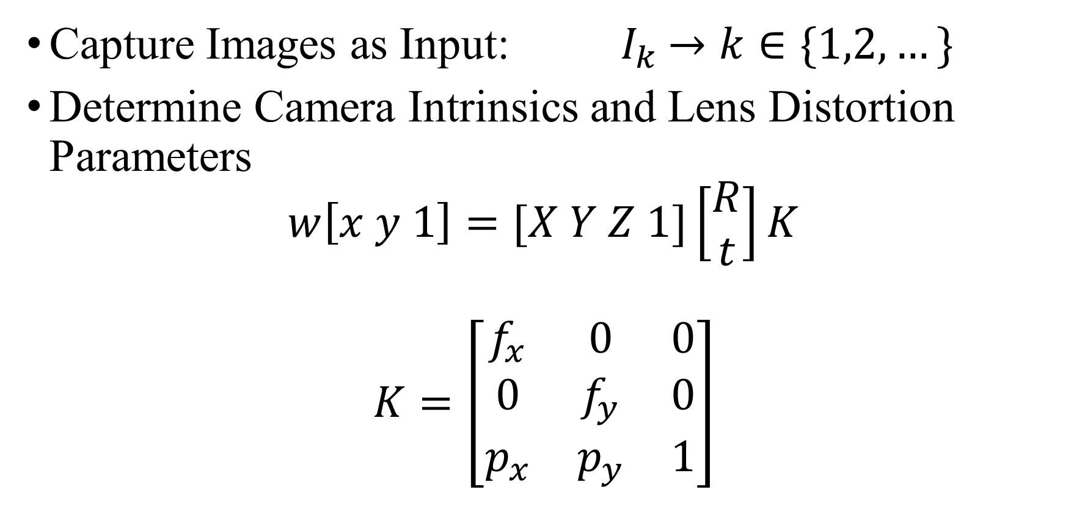
General Algorithm
Capture Images as Input:${ I}_{k} →k∈\{1,2,…\}$
Determine Camera Intrinsics and Lens Distortion Parameters
$$w\left[x y 1\right]=[X Y Z 1]\left[\begin{matrix}R \\ t\end{matrix}\right]K$$
$$K=\left[\begin{matrix}f_{x} & 0 & 0 \\ 0 & f_{y} & 0 \\ p_{x} & p_{y} & 1\end{matrix}\right]$$

Slide 4
LensDistortion
Radial distortion occurs when light rays bend more near the edges of a lens than they do at its optical center
x_{distorted} = x(1 + k₁*r² + k₂*r⁴ + k₃*r⁶)
y_{distorted}= y(1 + k₁*r² + k₂*r⁴ + k₃*r⁶)
Tangential distortion occurs when the lens and the image plane are not parallel
x_{distorted} = x + (2 * p₁ * x * y + p₂ * (r² + 2 * x²))
y_{distorted} = y + (p₁ * (r² + 2 *y²) + 2 * p₂ * x * y)

Slide 5
Matlab Camera Calibration Algorithm
Solve for the intrinsics and extrinsics in closed form, assuming that lens distortion is zero
Estimate parameters simultaneously, including the distortion coefficients, using nonlinear least-squares minimization (Levenberg–Marquardt algorithm) setting the initial estimate of the intrinsics and extrinsics to the preceding step and the distortion coefficients to zero

Slide 6
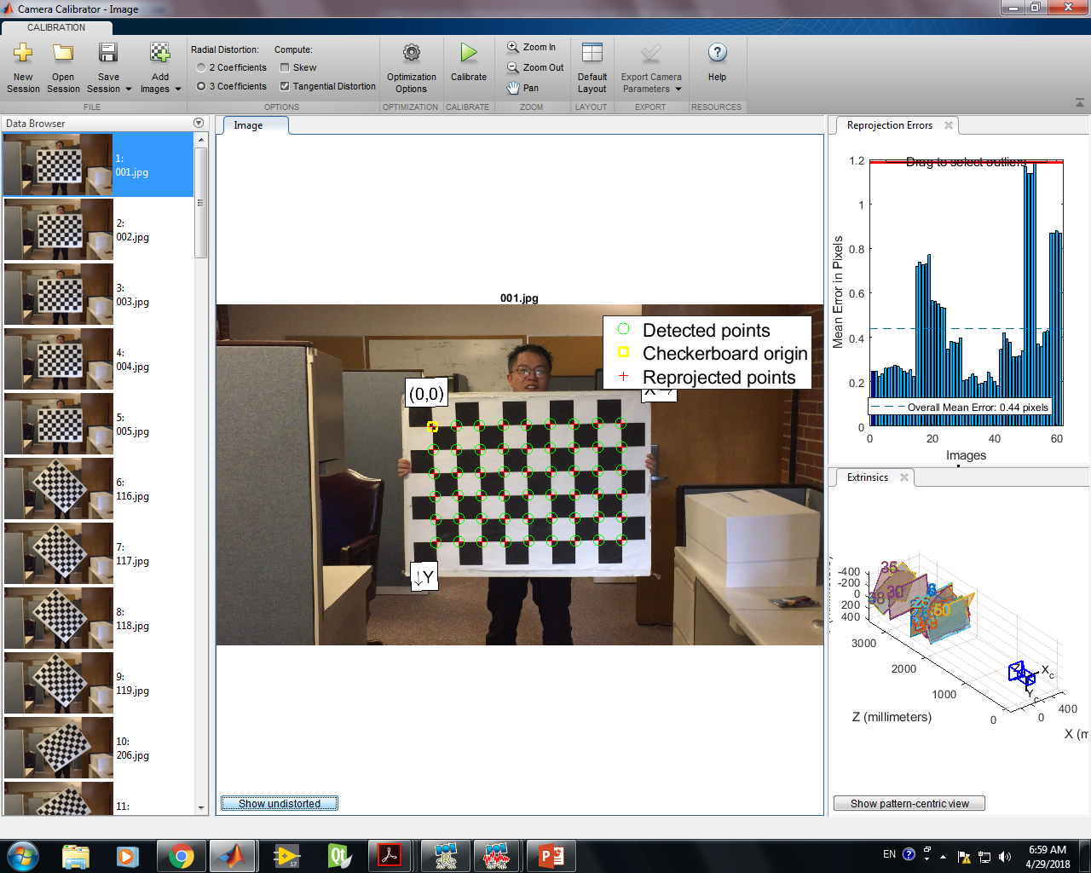

Slide 7
My Iphone 6 Camera Parameters
Parameter | Estimated Value
Image Size_{x} | 1920
Image Size_{x} | 1080
f_{x} | 1890.1946
f_{y} | 1887.7924
p_{x} | 934.0193
p_{y} | 524.4038
k₁ | -0.0935
k₂ | 0.5849
k₃ | 00376
p₁ | -0.0030
p₂ | -0.0029

Slide 8
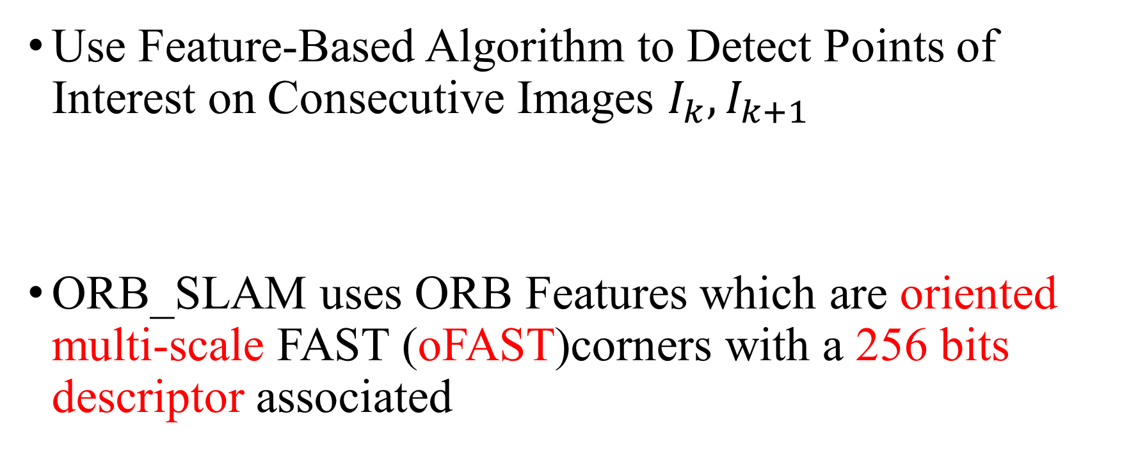
General Algorithm
Use Feature-Based Algorithm to Detect Points of Interest on Consecutive Images $I_{k},I_{k+1}$
ORB_SLAM uses ORB Features which are oriented multi-scale FAST (oFAST)corners with a 256 bits descriptor associated

Slide 9
ORB Keypoints
FAST and its variants are the method of choice for finding keypoints in real-time systems that match visual features.
It is efficient and finds reasonable corner keypoints, although it must be augmented by a Harris corner filter to reject edges and provide a reasonable score.
Many keypoint detectors include an orientation operator (SIFT and SURF are two prominent examples), but FAST does not.

Slide 10
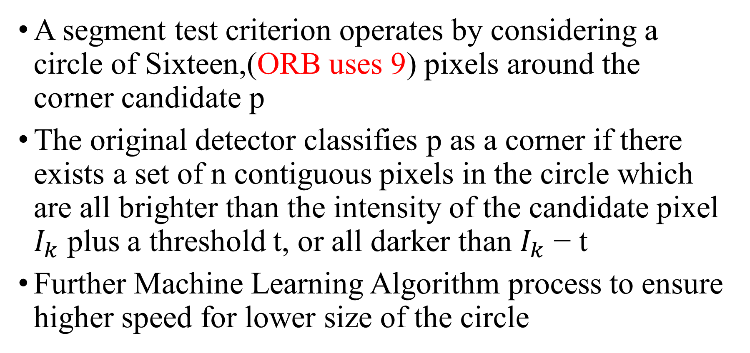
FAST: Features from Accelerated Segment Test
A segment test criterion operates by considering a circle of Sixteen,(ORB uses 9) pixels around the corner candidate p
The original detector classifies p as a corner if there exists a set of n contiguous pixels in the circle which are all brighter than the intensity of the candidate pixel $I_{k}$ plus a threshold t, or all darker than $I_{k}$ − t
Further Machine Learning Algorithm process to ensure higher speed for lower size of the circle

Slide 11
FAST

Slide 12
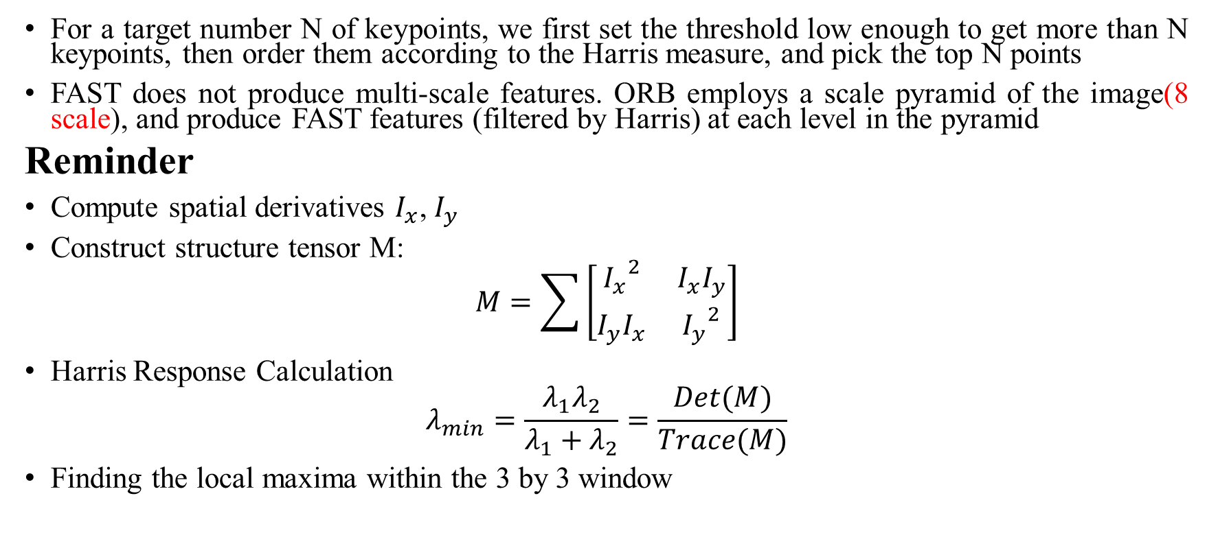
Harris Filter Augmentation
For a target number N of keypoints, we first set the threshold low enough to get more than N keypoints, then order them according to the Harris measure, and pick the top N points
FAST does not produce multi-scale features. ORB employs a scale pyramid of the image(8 scale), and produce FAST features (filtered by Harris) at each level in the pyramid
Reminder
Compute spatial derivatives $I_{x}$, $I_{y}$
Construct structure tensor M:
$$M=\sum{\left[\begin{matrix}{I_{x}}^{2} & I_{x}I_{y} \\ I_{y}I_{x} & {I_{y}}^{2}\end{matrix}\right]}$$
Harris Response Calculation
$$λ_{min}=\frac{λ_{1}λ_{2}}{λ_{1}+λ_{2}}=\frac{Det(M)}{Trace(M)}$$
Finding the local maxima within the 3 by 3 window

Slide 13
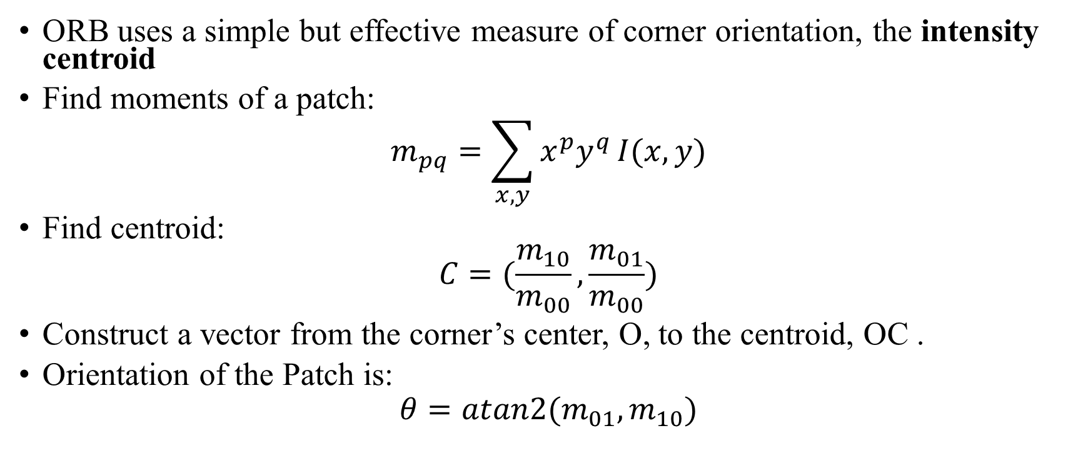
ORB Corner Orientation
ORB uses a simple but effective measure of corner orientation, the intensity centroid
Find moments of a patch:
$$m_{pq}=\sum_{x,y}{x^{p}y^{q}}I(x,y)$$
Find centroid:
$$C=(\frac{m_{10}}{m_{00}},\frac{m_{01}}{m_{00}})$$
Construct a vector from the corner’s center, O, to the centroid, OC .
Orientation of the Patch is:
$$θ=atan2(m_{01},m_{10})$$

Slide 14
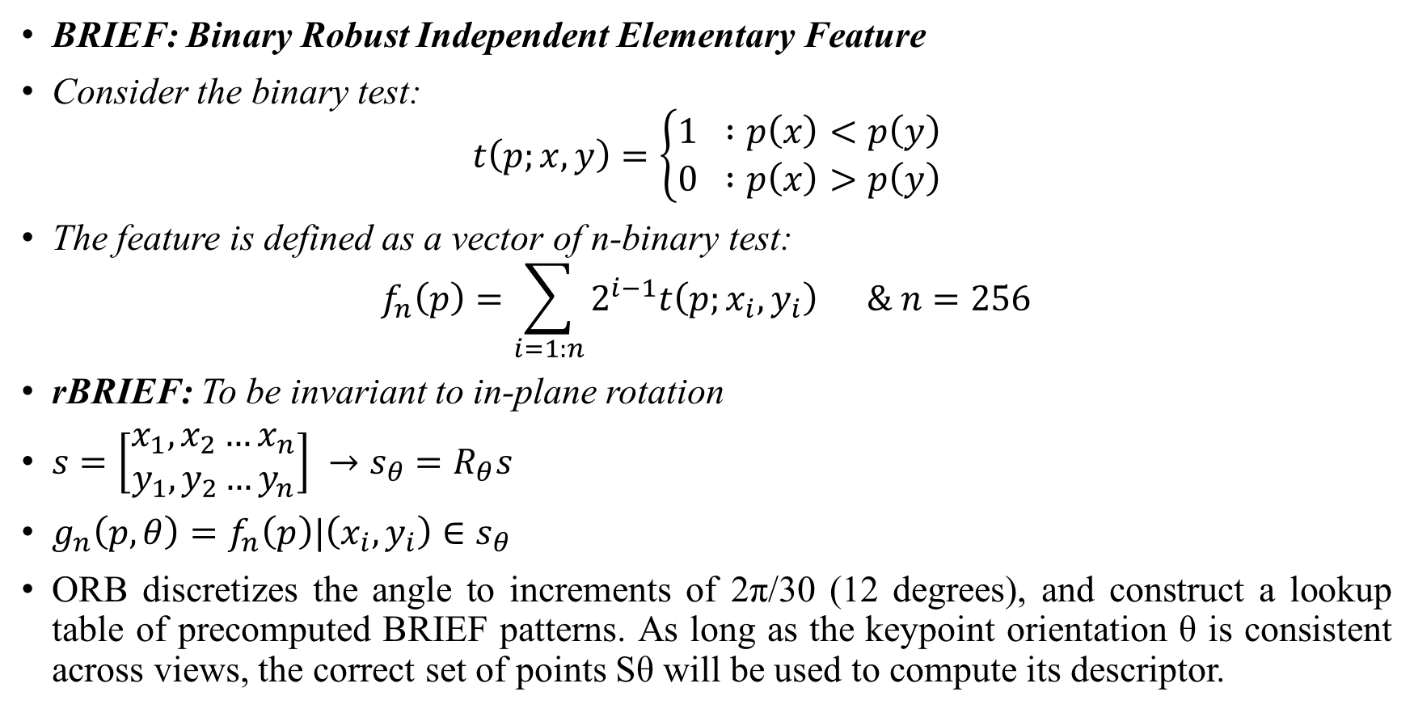
ORB Descriptor
BRIEF: Binary Robust Independent Elementary Feature
Consider the binary test:
$$t\left(p;x,y\right)=\left\{\begin{matrix}1 :p\left(x\right)<p\left(y\right) \\ 0 :p\left(x\right)>p\left(y\right)\end{matrix}\right.$$
The feature is defined as a vector of n-binary test:
$$f_{n}\left(p\right)=\sum_{i=1:n}{2^{i−1}t\left(p;x_{i},y_{i}\right) \& n=256}$$
rBRIEF: To be invariant to in-plane rotation
$s=\left[\begin{matrix}x_{1},x_{2}…x_{n} \\ y_{1},y_{2}…y_{n}\end{matrix}\right] →s_{θ}=R_{θ}s$
$g_{n}\left(p,θ\right)=f_{n}\left(p\right)|\left(x_{i},y_{i}\right)∈s_{θ}$
ORB discretizes the angle to increments of 2π/30 (12 degrees), and construct a lookup table of precomputed BRIEF patterns. As long as the keypoint orientation θ is consistent across views, the correct set of points Sθ will be used to compute its descriptor.

Slide 15
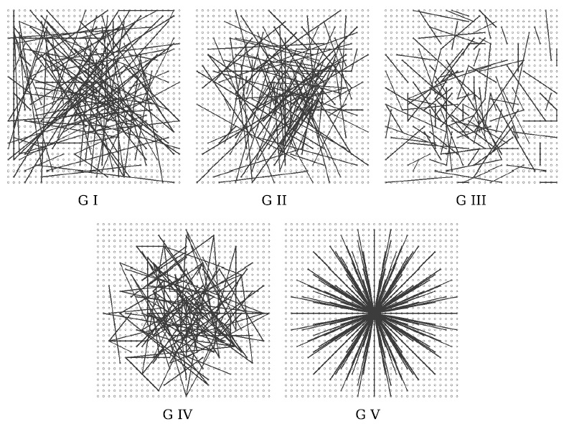

Slide 16


Initialization
Find Initial Correspondences
Parallel Computation of Homography and Fundamental Matrix
8-point in Each Iteration RANSAC
$$x_{t}^{T}F_{t,t−1}x_{t−1}=0$$
$$x_{t}={H_{t,t−1}x}_{t−1}$$
Normalized DLT

Slide 17
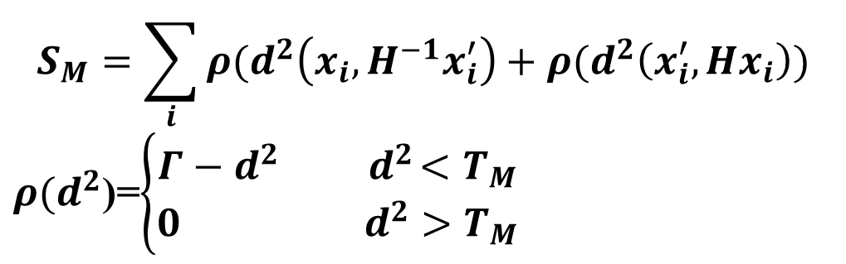


Initialization
Structure From Motion Recovery
Full Bundle Adjustment
If the Scene is Planar
Choose H
If not
Choose F
$$R_{H}=\frac{S_{H}}{S_{H}+S_{F}}$$
$$R_{H}>0.45$$
$$S_{M}=\sum_{i}{ρ(d^{2}\left(x_{i},H^{−1}x_{i}^{′}\right)+ρ(d^{2}\left(x_{i}^{′},Hx_{i}\right))}$$
$ρ(d^{2}$)=$\left\{\begin{matrix}Γ−d^{2}{ d}^{2}<T_{M} \\ 0{ d}^{2}>T_{M}\end{matrix}\right.$

Slide 18
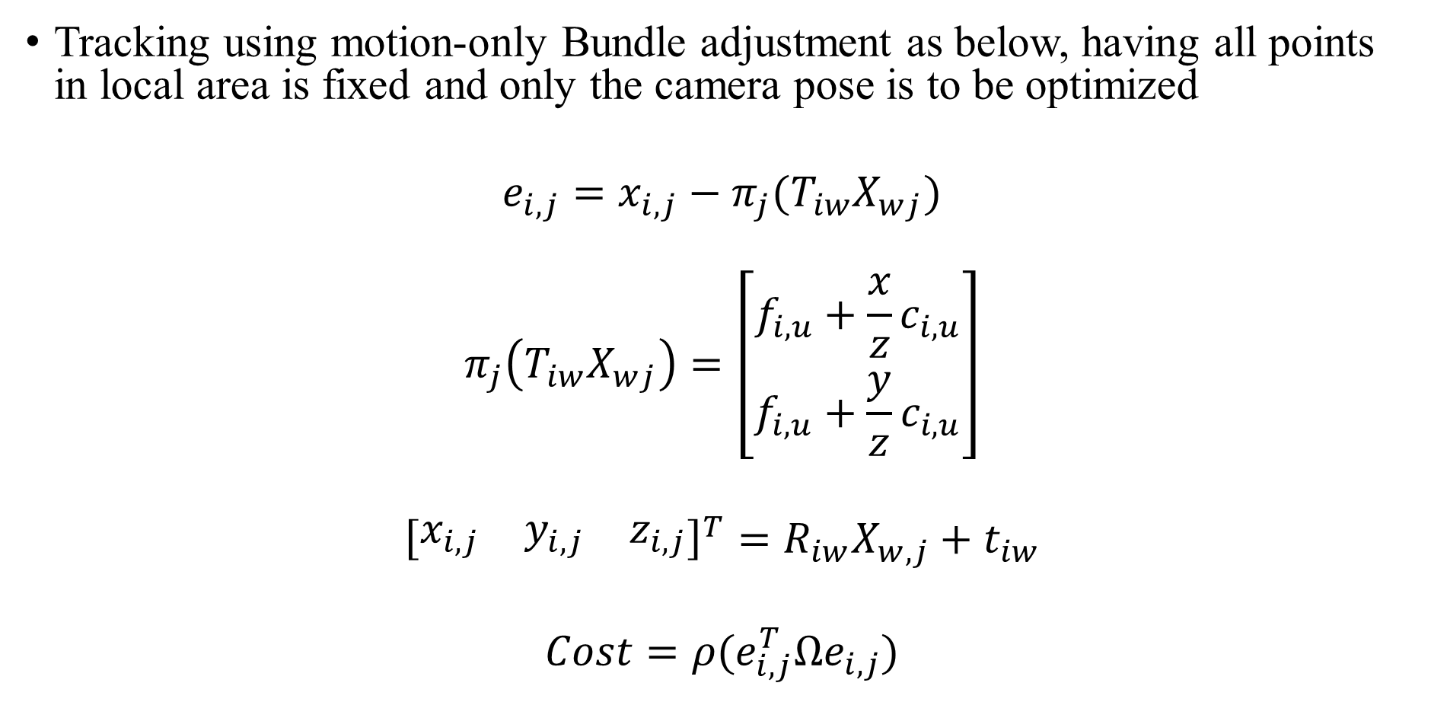
ORB Tracking
Tracking using motion-only Bundle adjustment as below, having all points in local area is fixed and only the camera pose is to be optimized
$$e_{i,j}=x_{i,j}−π_{j}(T_{iw}X_{wj})$$
$$π_{j}\left(T_{iw}X_{wj}\right)=\left[\begin{matrix}f_{i,u}+\frac{x}{z}c_{i,u} \\ f_{i,u}+\frac{y}{z}c_{i,u}\end{matrix}\right]$$
$${\left[\begin{matrix}x_{i,j} & y_{i,j} & z_{i,j}\end{matrix}\right]}^{T}=R_{iw}X_{w,j}+t_{iw}$$
$$Cost=ρ(e_{i,j}^{T}Ωe_{i,j})$$

Slide 19
ORB Tracking
If tracking was successful for last frame, the algorithm uses a constant velocity motion model to predict the camera pose and perform a guided search of the map points observed in the last frame.
If not enough matches were found, it uses a wider search of the map points around their position in the last frame. The pose is then optimized with the found correspondences

Slide 20
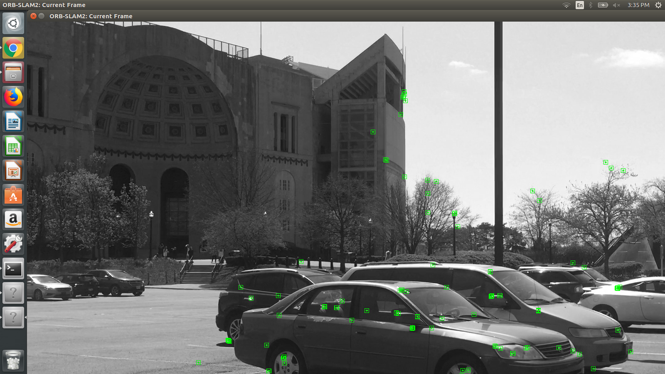
Results

Slide 21
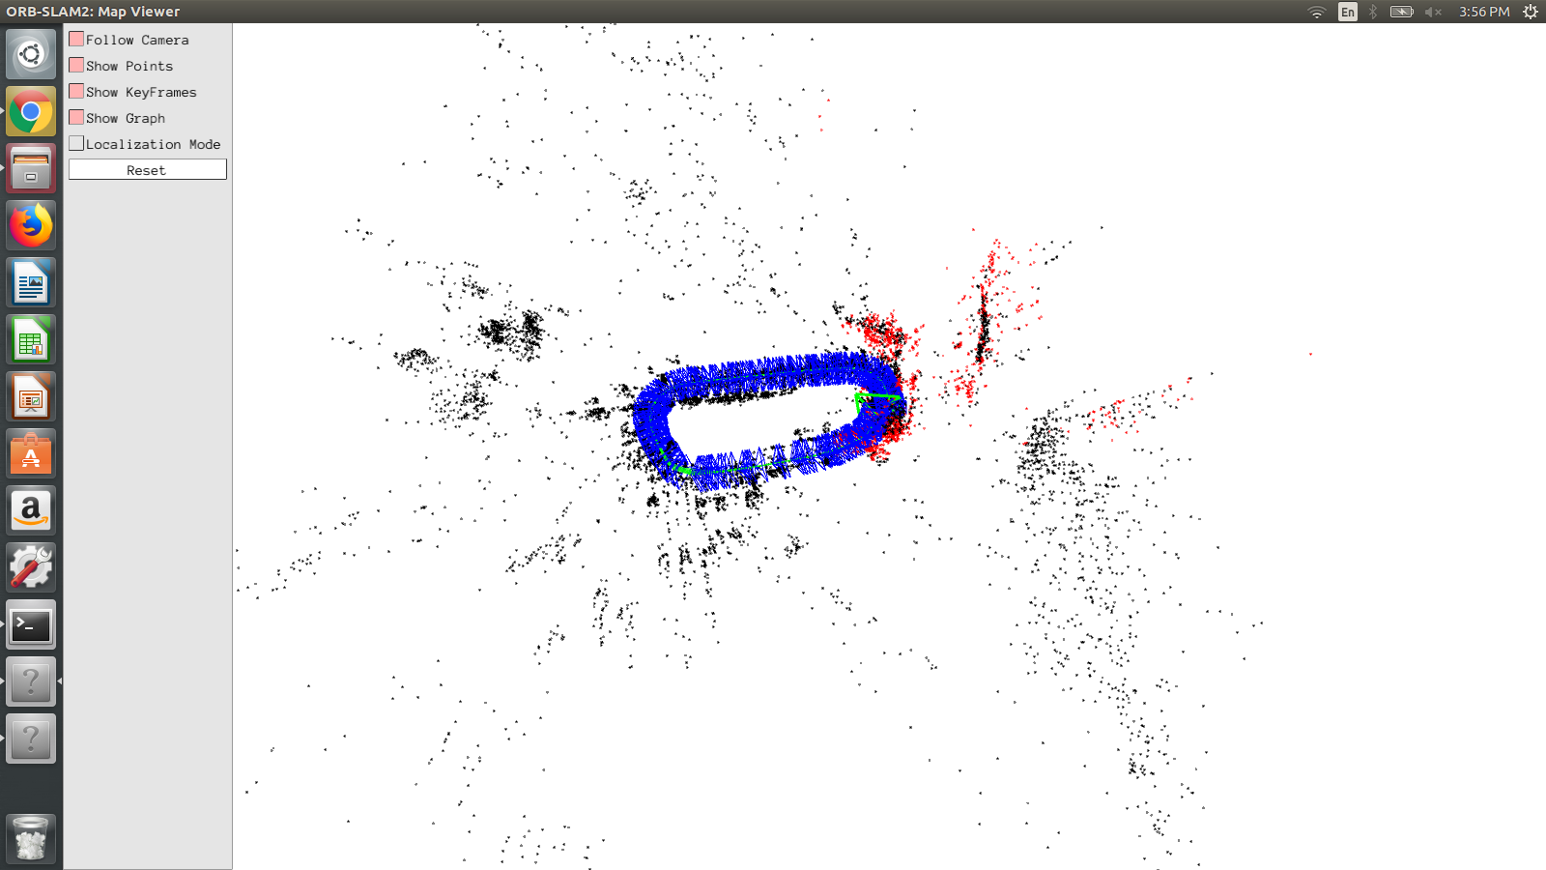
Results

Slide 22
Results

Slide 23
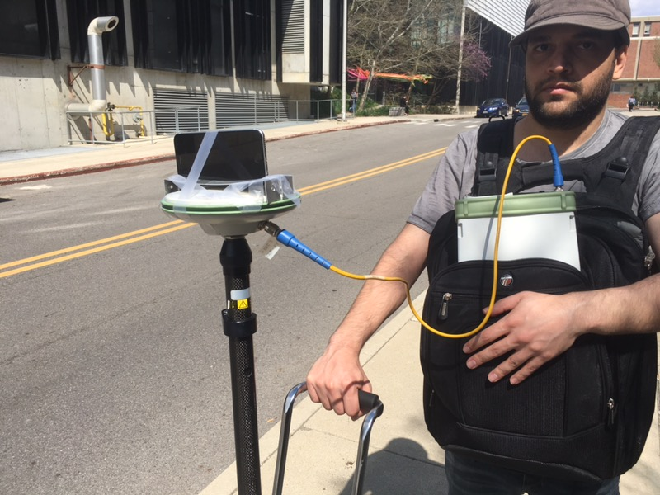

Slide 24
References
[1] R. Mur-Artal, J. M. M. Montiel, and J. D. Tardos, “ORB-SLAM: a ´ versatile and accurate monocular SLAM system,” IEEE Trans. Robot., vol. 31, no. 5, pp. 1147–1163, 2015.
[2] E. Rublee, V. Rabaud, K. Konolige, and G. Bradski, “ORB: an efficient alternative to SIFT or SURF,” in IEEE International Conference on Computer Vision (ICCV), Barcelona, Spain, November 2011, pp. 2564– 2571

Slide 25
Questions?

